Slide 1
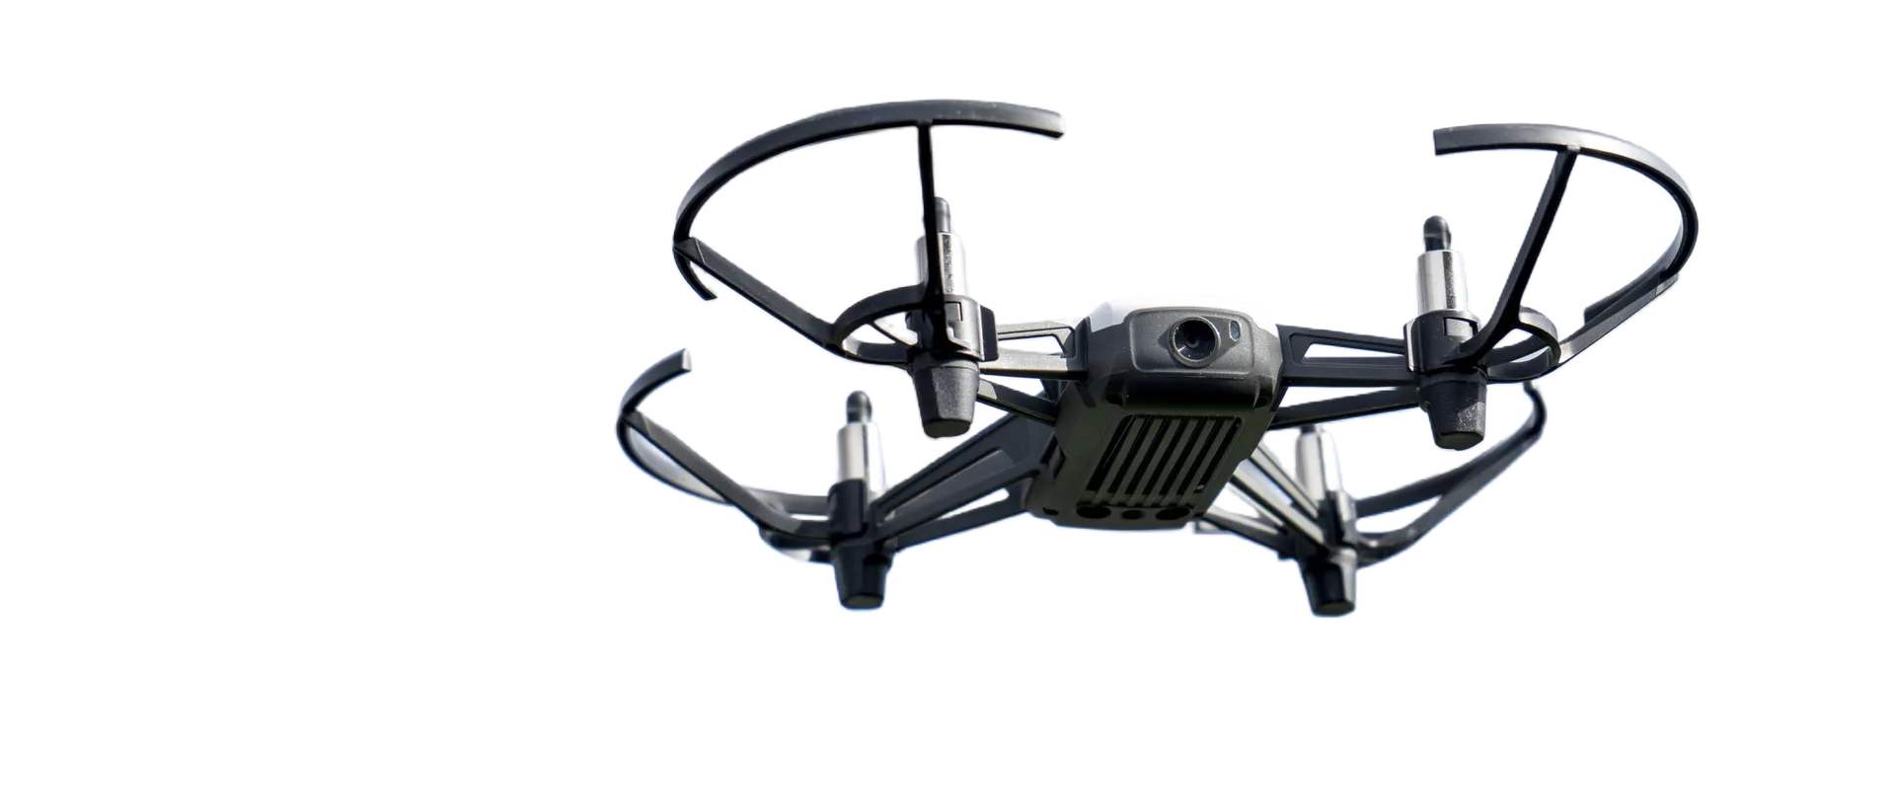
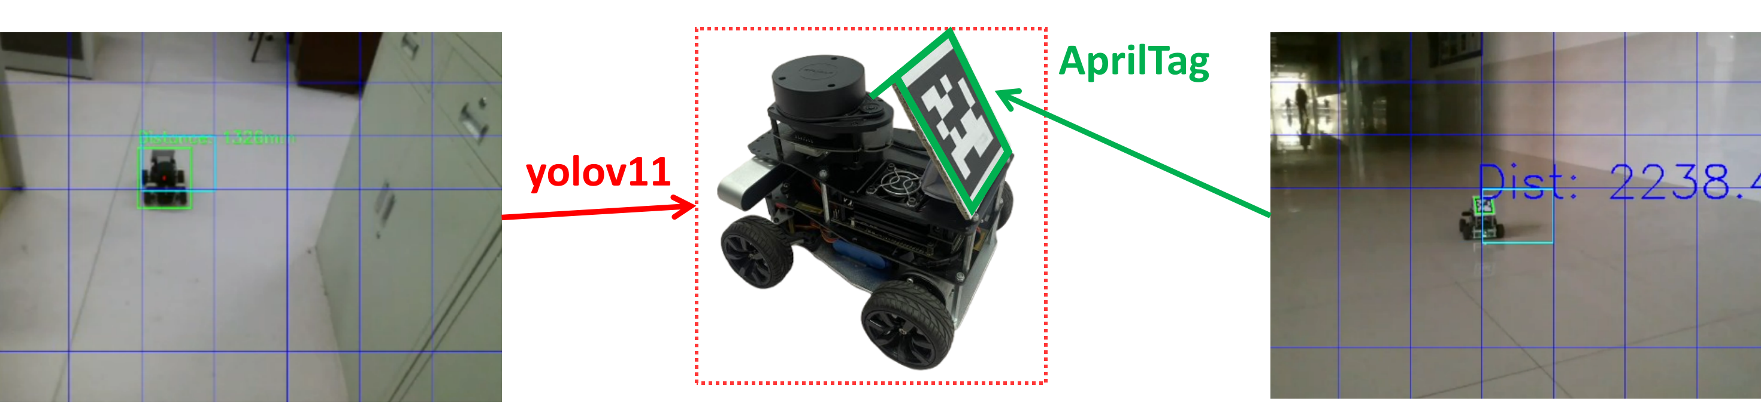
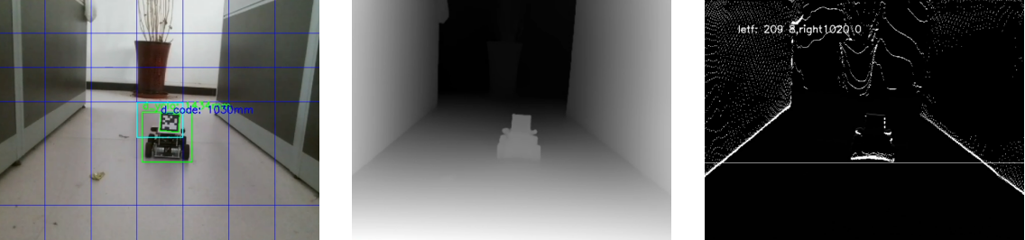
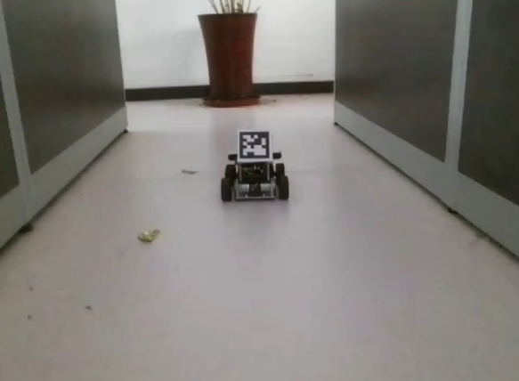
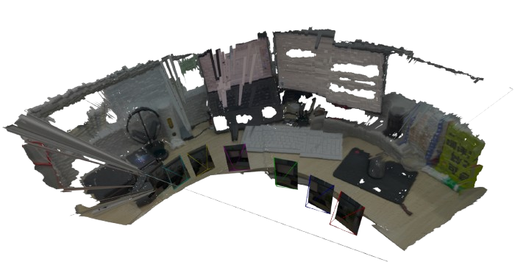
Target-Guided 3D Reconstruction Based on Tello Drone
Task Modeling
Technical Analysis
1. YOLO + AprilTag for tracking and distance control.
1. Drone follows target vehicle, maintaining visual contact through flight control.
2. Dynamic obstacle avoidance with algorithms ensuring post-avoidance tracking.
3. RGB-based 3D reconstruction, excluding moving vehicle from static scene.
2. DepthAnything for depth estimation, Sobel operator for edge-based obstacle avoidance while tracking vehicle.
Key Challenges
1 . Multi-view vehicle tracking & distance estimation
2 . RGB-only depth estimation
3 . Obstacle detection & control
4 . LiDAR/sonar-free 3D reconstruction
5 . Dynamic object filtering
3. Mast3r-SLAM for 3D reconstruction, YOLO filters moving objects.

Slide 2

02
AprilTag-Based Tracking with YOLOv11
CONTENTS
03
Dynamic Obstacle Avoidance
04
3D Reconstruction System

Slide 3
PART 02
AprilTag-Based Tracking with YOLOv11
Notes:
优势、yolo、apriltag、飞控

Slide 4
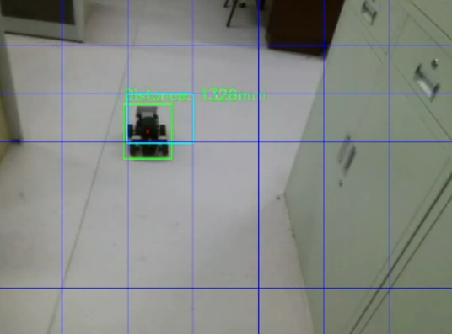
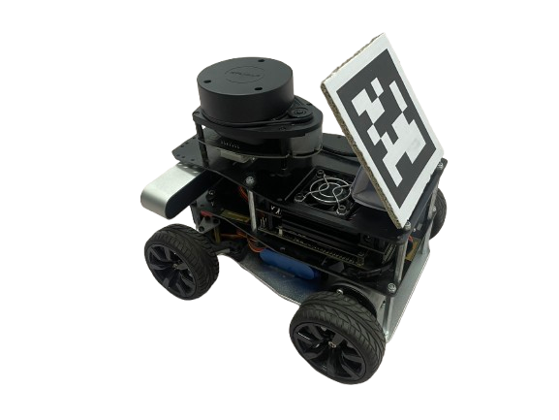
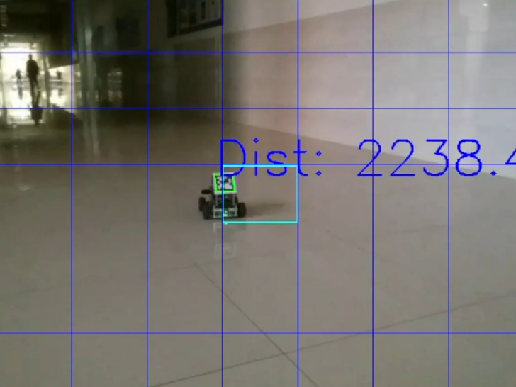

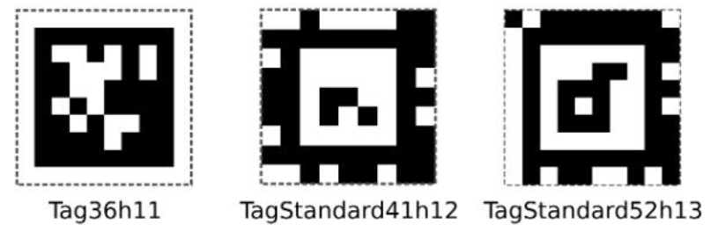
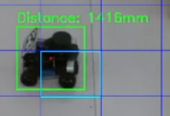
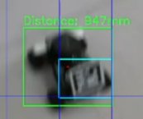

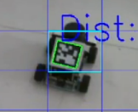
Benefits of YOLOv11 & AprilTag
Dual Detection Advantage:
YOLO flexibility + AprilTag accuracy
Yolo Features
Adv: Various angles
Disadv: distance estimation is not accurate.
YOLO extreme
condition testing
Apriltag extreme
condition testing
Apriltag Features
Adv: Precise distance measurement from the front
Disadv:Less robust to angle changes
Yolo特点

Slide 5
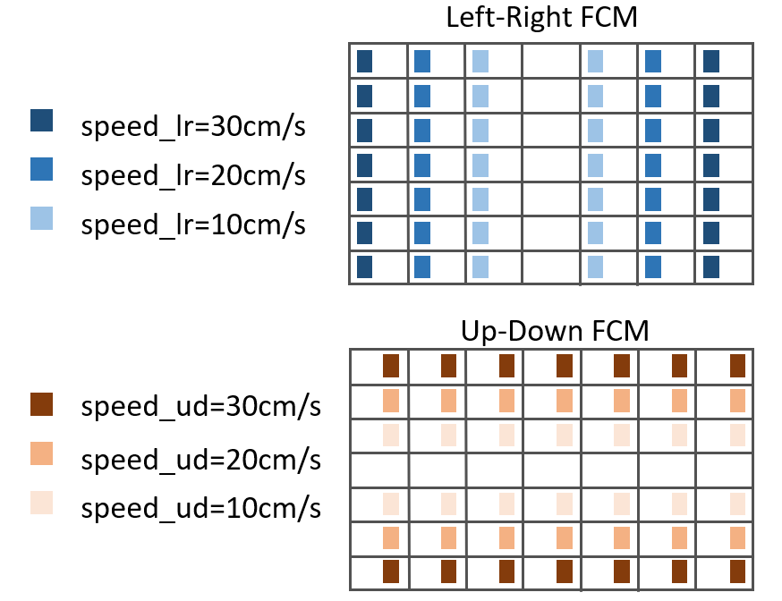
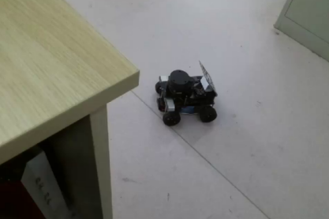

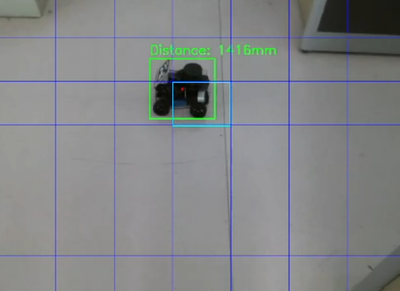
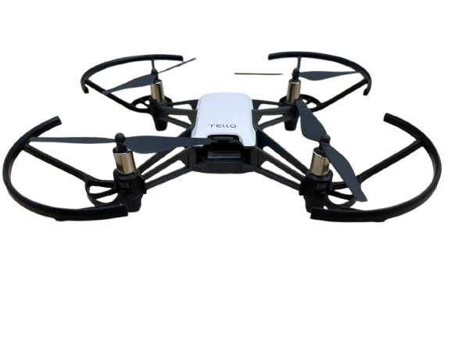
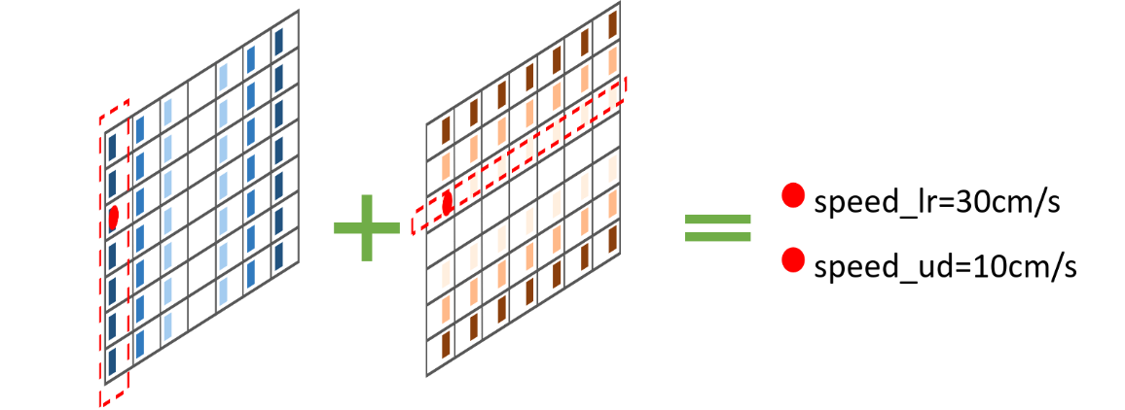

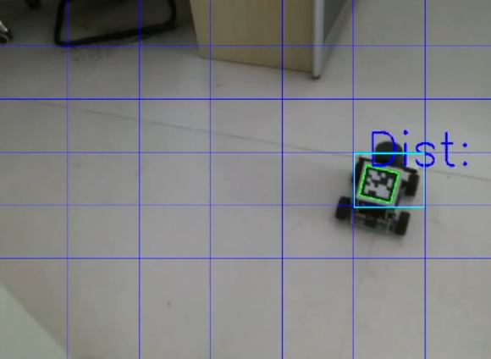
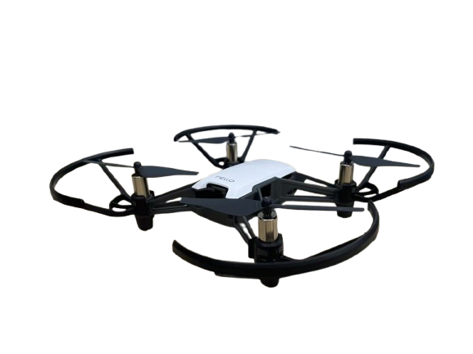





Target guide tracking
01
Target information processing
Flight controller matrix
02
1. Grid overlay
2. YOLO detection
3. Rough distance
measurement
4. Precise distance
measurement
Velocity decreases from edges to center
(30cm/s → 0, decreasing 10cm/s per step).
Case 1. with AprilTag
Case 2. without AprilTag
Flight controller matrix
Overlay a 7×7 grid
Case1:without AprilTag
Apriltag_distance=null
yolo_distance=1416
Wicth grid cell containing target
e.g. Located at row 3, column 1, denoted as A(1,3)
At this point, speed_lr= 30 cm/s, speed_ud= 10 cm/s.
210 mm
21 pix
Case2: with AprilTag
240 mm
O
24 pix
Apriltag_distance=2100
distance
f
yolo_distance=2116
$$yolo_distance=\frac{f × \sqrt{area_real}}{\sqrt{area_pix}}$$
$$AprilTag_distance$$
$$Camera_post$$
$$APrilTag_location$$

Slide 6
PART 03
Dynamic
Obstacle Avoidance
Notes:
depthanything原理、sobel算子障碍判断、壁障实现

Slide 7
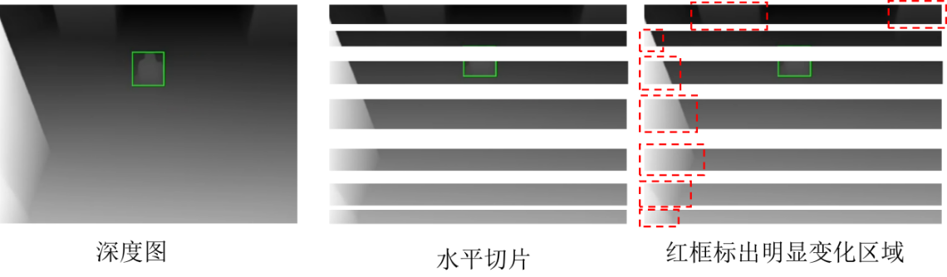
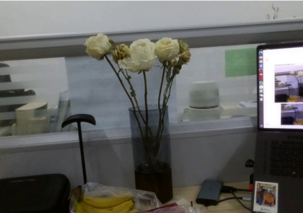
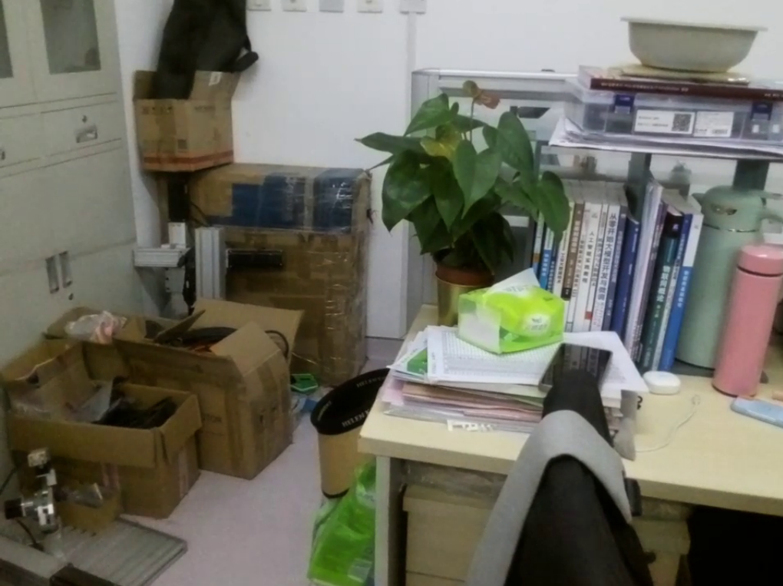
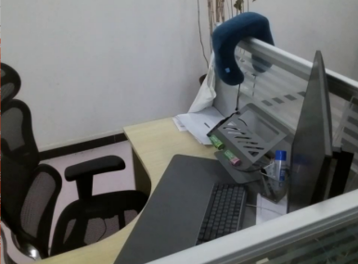
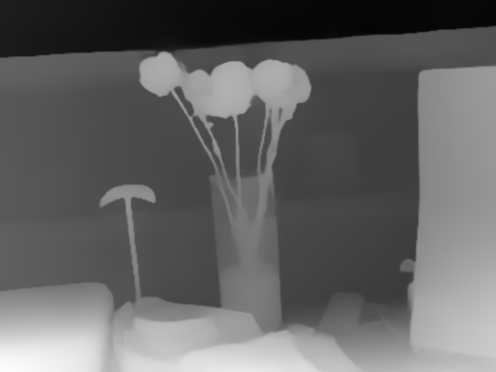
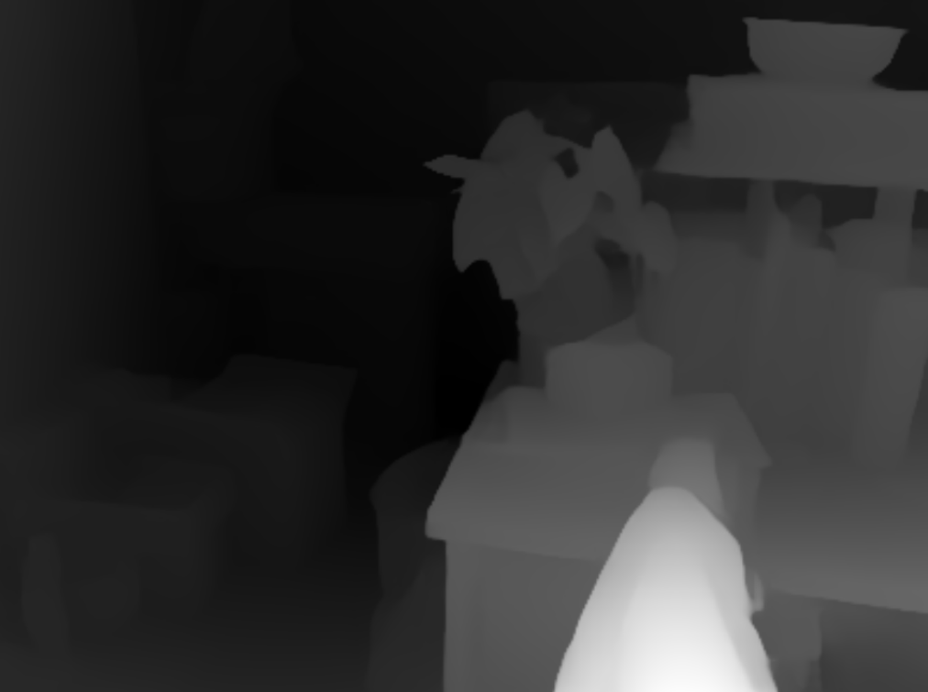
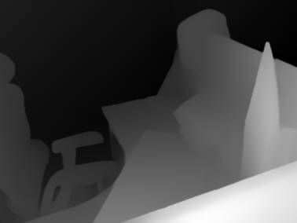
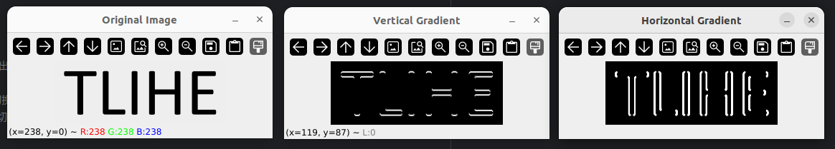
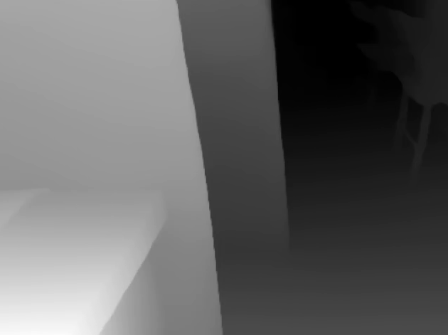
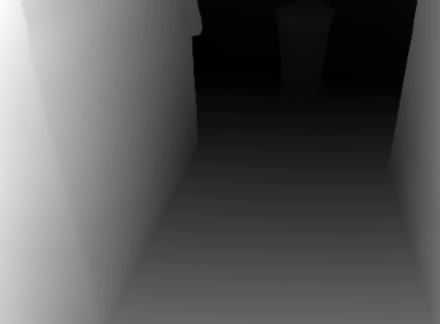
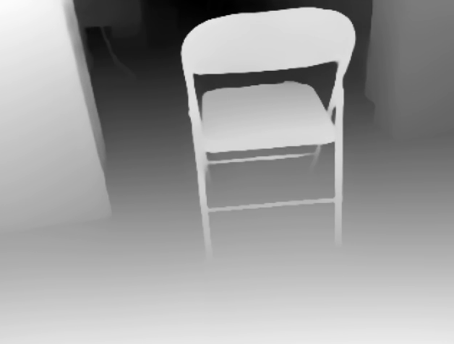
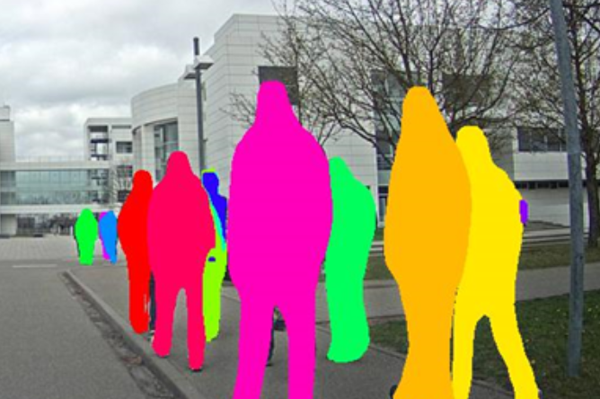

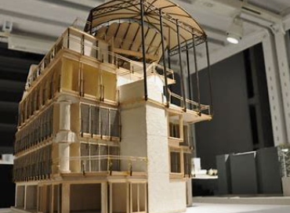
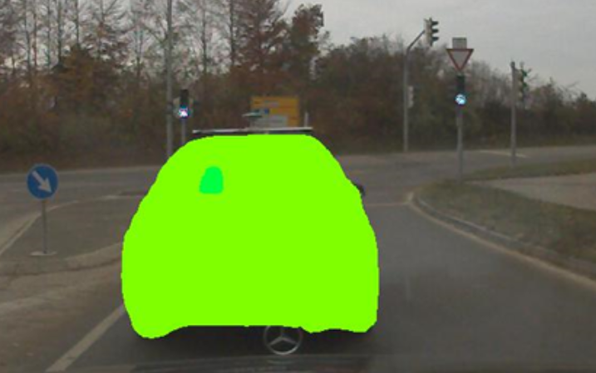
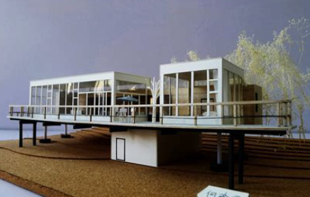
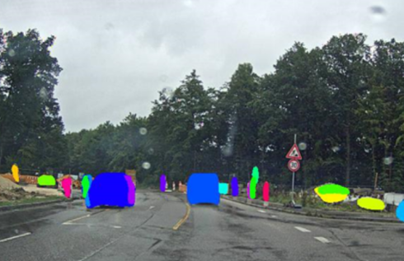
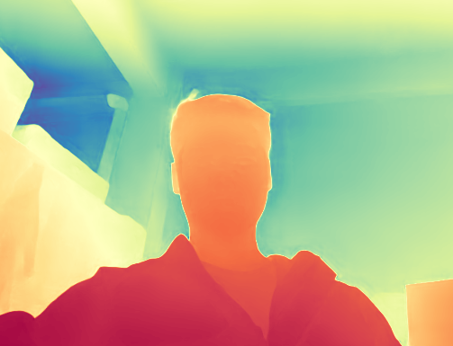


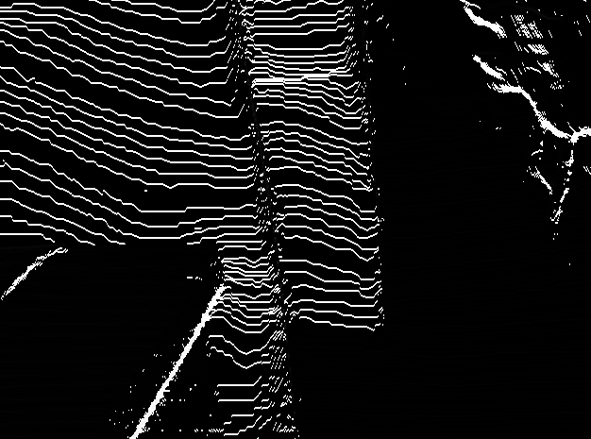
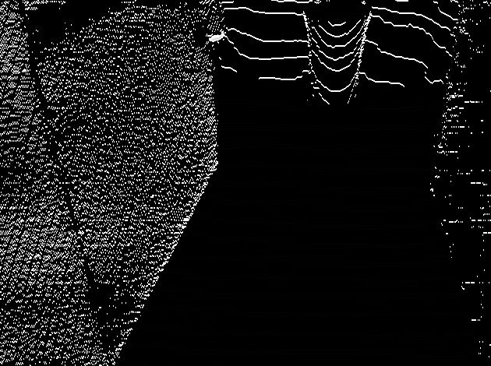
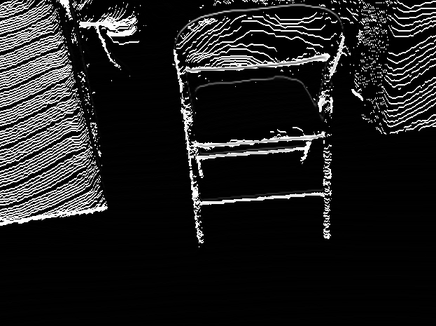
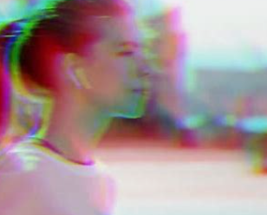

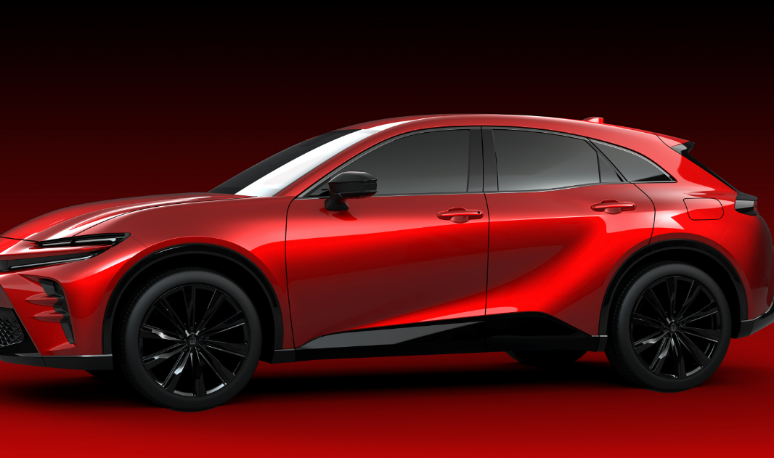

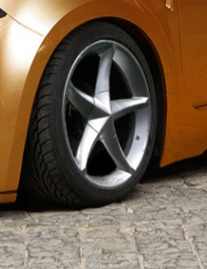
DepthAnything & Sobel operator
02
Sobel operator obstacle detection
Aprilta特点
Depth Map Creation
“Ground” depth maps show linear variation with distance (left). Horizontal slicing reveals that most areas have minimal gradient change, while significant changes indicate obstacles (right).
01
Depth Anything serves as a substitute for depth sensing hardware. Depth values are normalized to the range 0-255
Sobel is a gradient-based edge detector using X and Y directional gradients. Here, only the horizontal filter is applied.
Test case 1
Test case 2
Test case 3
Employs knowledge distillation: a teacher model trained on large labeled datasets guides a smaller student model to achieve the same task with minimal accuracy loss.
comparison between the depth map and obstacle detection map.
LiDAR dataset
T’s Generated dataset
Teacher model（T）
Train
T
inference
Noise
Student model（S）
S
Train
Color jitter
Gaussian blur
CutMix
Test case 1
Test case 2
Test case 3

Slide 8
PART 04
3D Reconstruction System

Slide 9
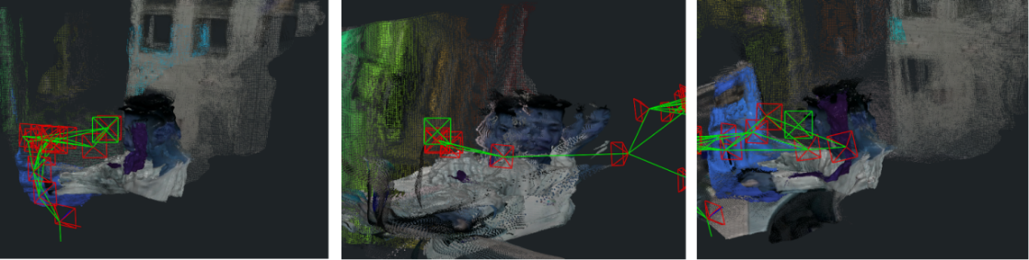
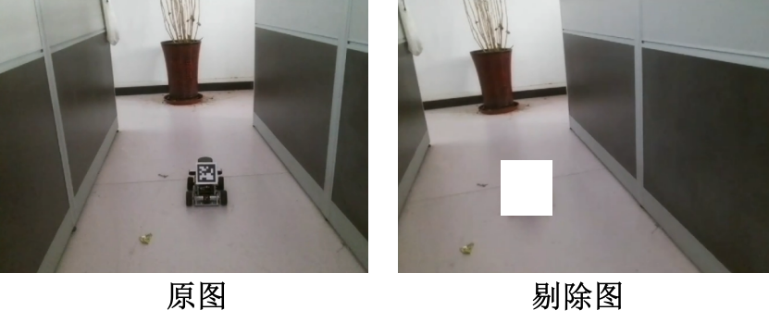

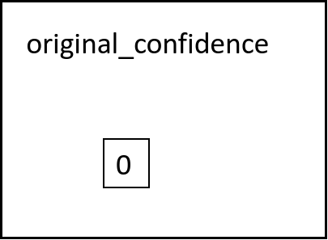
MASt3R-SLAM
Principle & improvements
Challenge: Dynamic objects impact static environment
Moving objects interfere with vehicle-guided drone mapping by causing feature matching errors that deform static point clouds.
Three stages of MASt3R-SLAM
Initialization
stage
Creates the first keyframe and initial map by processing the first frame through MASt3R to generate pointmap and encoded features.
Solution: Vehicle Removal
Expand YOLO detection region by 3 pixels outward and apply a transparent mask over the vehicle area.
Tracking stage
Estimates current frame pose through efficient pointmap matching with recent keyframes and performs local map fusion.
Implementation: Add Alpha Channel
Use alpha channel to convert input image to RGBA format
Adjust initialization to skip tracking phase for masked regions
Set confidence to 0 in masked areas
Relocalization
stage
Recovers tracking by matching current frame against the global map database when tracking fails or error accumulates.

